Slide 1

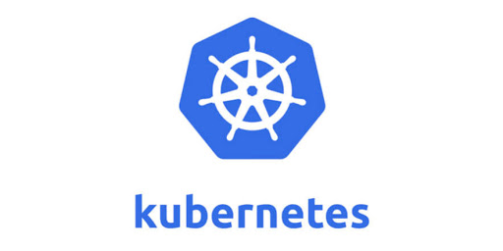
An Introduction

Slide 2
AGANDA
Introduction to Kubernetes concepts.
Sample Project
Q & A with common problems you will face as a beginner.
IEEE SUMMER SCHOOL ASR 2021

Slide 3
WHY KUBERNETES ?
Kubernetes is an Open Source Container Orchestration tool developed by Google.
It helps you to manage Containerized Applications in different deployment Environments.
To know the need of Kubernetes we have to know about the need of Container Orchestration .
IEEE SUMMER SCHOOL ASR 2021

Slide 4
NEED FOR CONTAINER ORCHESTRATION
In this Modern World , We don’t create applications for single use. We create it for multiple purpose .
Let’s take an Online Book Store , Here we have functions like Search , Pricing , Cart , Order , Payment.
When Lakhs of people enter the application at the same time , If the functions are being divided into separate places, traffic can happen without much hurdles.
For an E commerce Store like Amazon , we have lakhs of mini services in it .Hence it creates a demand for tools which can properly manage hundreds of Containers without affecting the performance of the application.
IEEE SUMMER SCHOOL ASR 2021

Slide 5
!! FEATURES KUBERNETES OFFER !!
High Availability of the Micro Services.
High Scalability for the users to have a sleek Hands-on experience with the application Rather than a Sturdy Slow one.
Disaster Recovery – Support when a particular Microservice goes down due to sudden high traffic it retains the state of the Microservice but also stores the Backup of the Microservice and loads it again after the Service Starts .
IEEE SUMMER SCHOOL ASR 2021

Slide 6
COMPONENTS IN KUBERNETES
KUBERNETES MASTER
This is the Controller of the Kubernetes Architecture and communicates with the worker nodes. It contains
API Server which acts as the Front End for the Administrator/Developer.
Control Manager – which monitors the stability of the Microservices in the Kubernetes Cluster.
Scheduler – which sends the deployed data to the control manager to initiate the stability control.
Etcd – which stores the Deployment Data.
KUBERNETES NODE
Kubelet – Present in every Node which communicates with the Kubernetes Master.
Pods – Pods are containers which contain Docker containers. Our Microservices will be running inside the pod .It is ideal to have only one Microservice inside one pod for Best performance. We can have multiple Microservices too in a pod .
Kube-Proxy – It is being used for users to communicate with the nods in a Cluster.
IEEE SUMMER SCHOOL ASR 2021

Slide 7
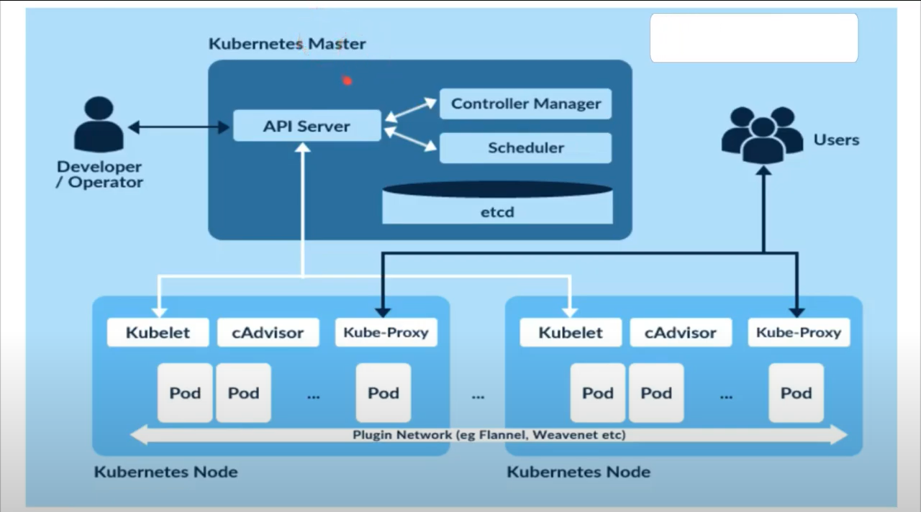
KUBERNETES ARCHITECTURE
IEEE SUMMER SCHOOL ASR 2021

Slide 8
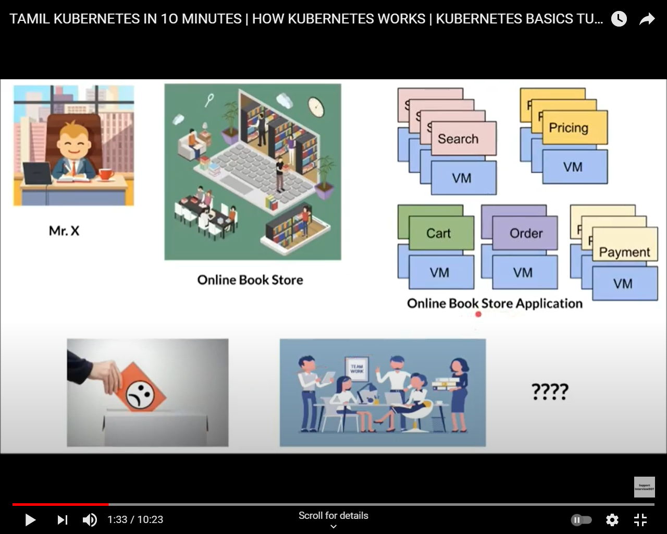
LET’S TAKE AN EXAMPLE
IEEE SUMMER SCHOOL ASR 2021

Slide 9
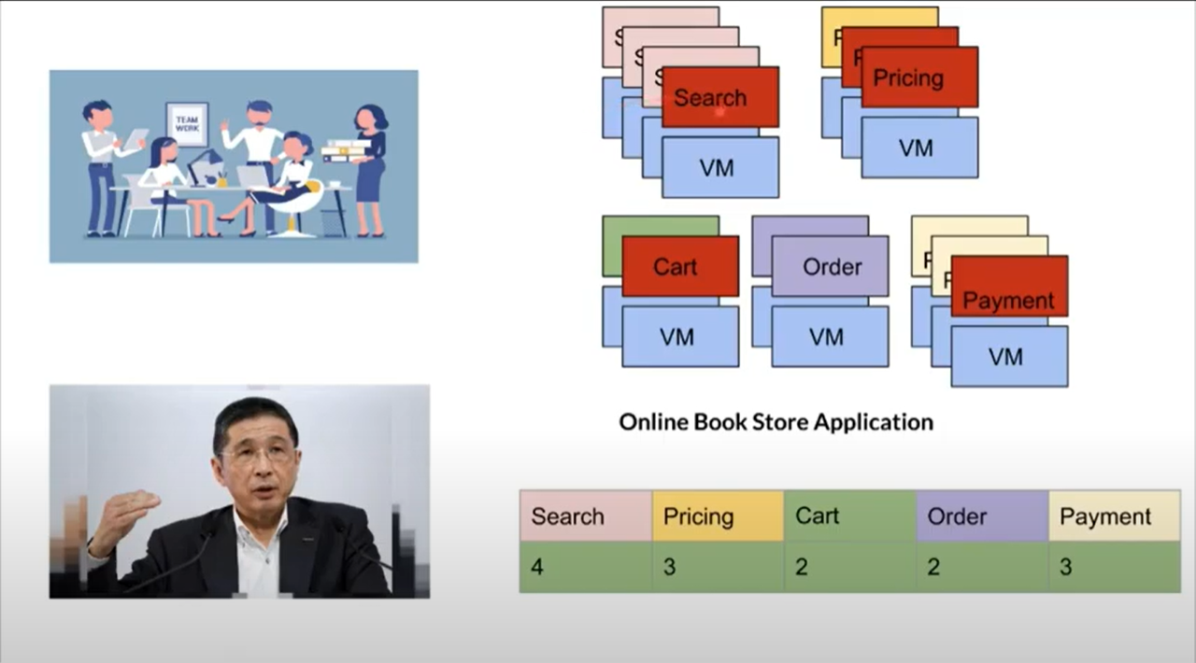
IEEE SUMMER SCHOOL ASR 2021

Slide 10
SO ONE PRESON IN THE TEAM SAYS THAT CAN BE THE BEST SOLUTION
IEEE SUMMER SCHOOL ASR 2021

Slide 11
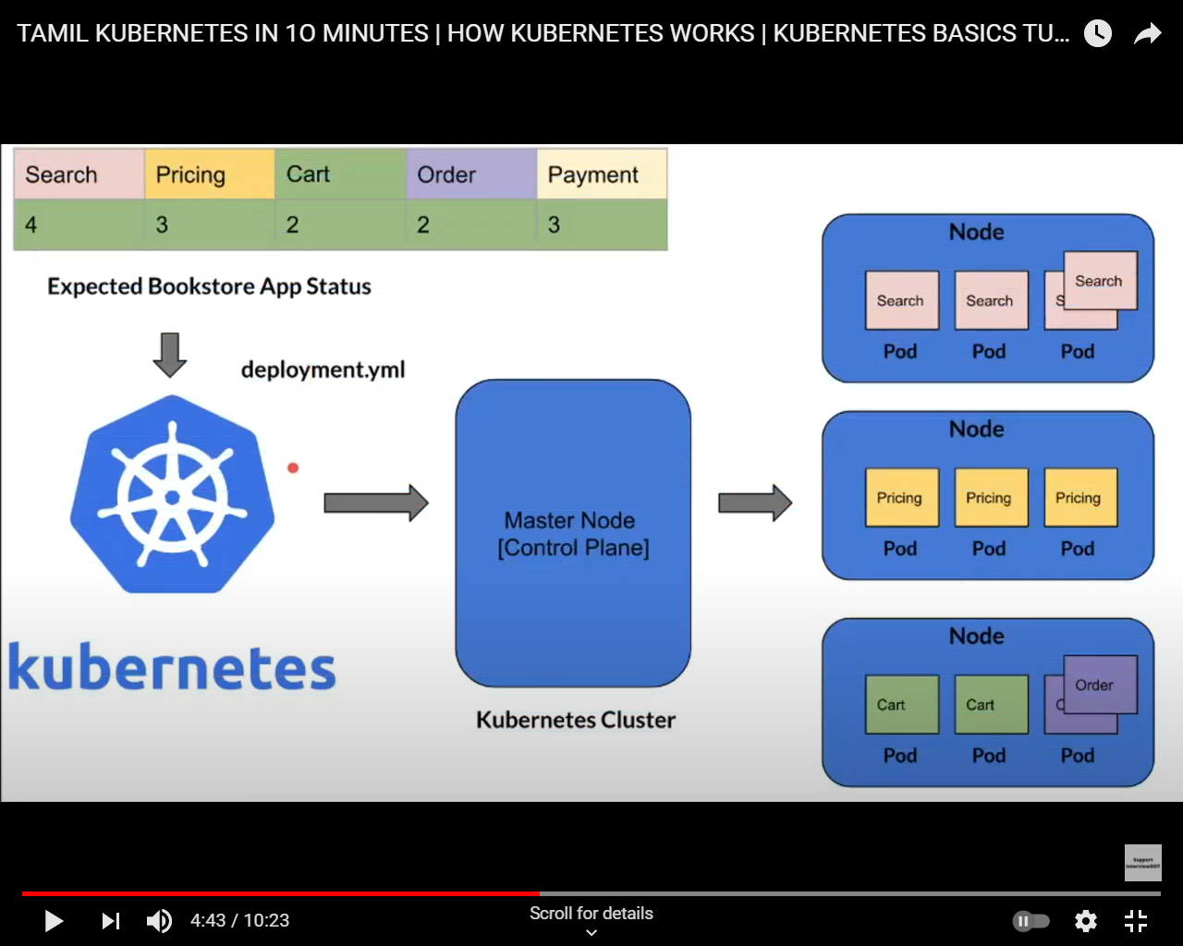
KUBERNETES ARCHITECTURE FOR ONLINE LIBARAY APPLICATION
IEEE SUMMER SCHOOL ASR 2021

Slide 12
THANK YOU FOR YOUR PARTICIPATION ANY QUESTIONS ?
IEEE SUMMER SCHOOL ASR 2021

Slide 13
LINKS FOR REFERENCE

